Slide 1
INTRODUCTION TO ANGULAR JS
PRESENTER: Umesh M
Training & Delivery Head,
IMC, Bangalore

Slide 2
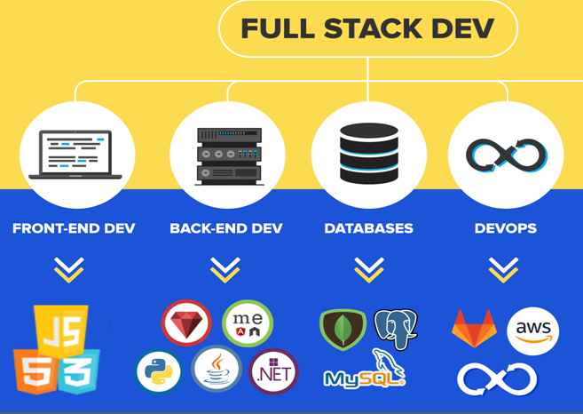

Slide 3
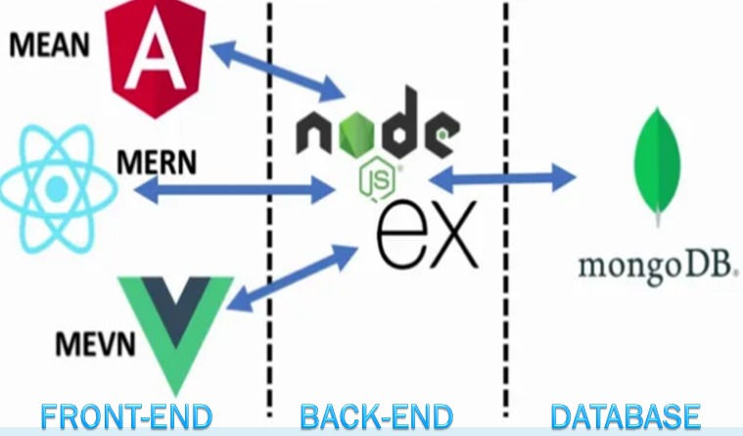

Slide 4


Slide 5
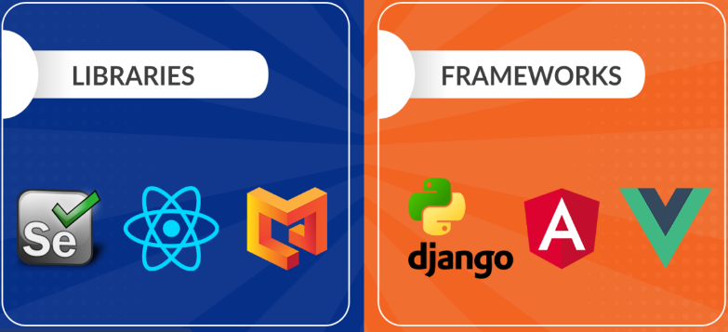

Slide 6
What is AngularJS?
Angular is client side framework
Angular is used to create web Applications
Angular is mainly used for Single Page Application(SPA) development
Angular is supported on all platforms(Desktop & mobile)
Angular is free & open source
Angular is having cross-browser compatibility.

Slide 7
AngularJS vs Angular ?

Slide 8
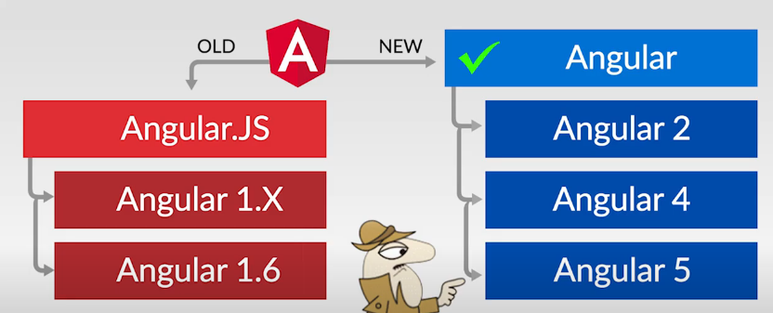

Slide 9
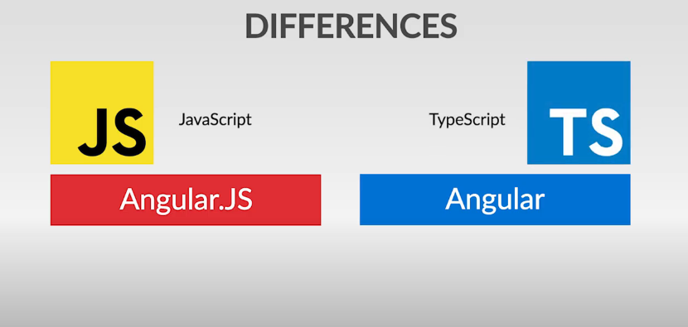
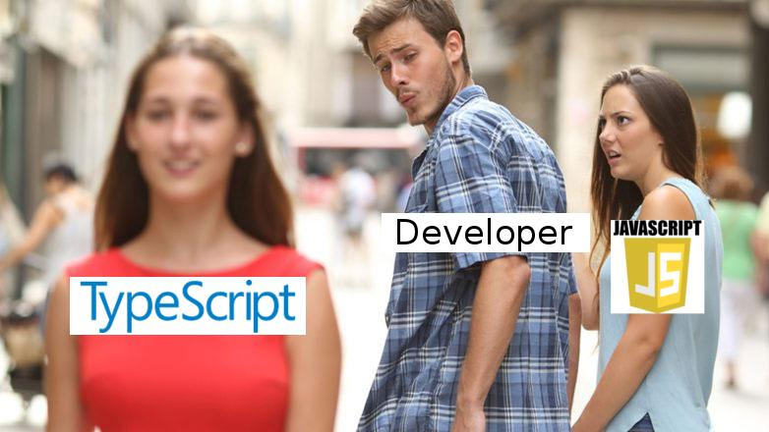

Slide 10
Angular History
Initial version of Angular(1.0) is called AngularJS which is developed using java script.
Angular 1.x versions are called AngularJS
From 2.0 onwards it is called Angular framework.
Angular 2.x and later versions are called Angular framework
Angular 2.x is completely re-written using Type script.
Type script developed by Microsoft company
Current version of Angular is 23

Slide 11
Why do we Choose AngularJS?
Some of the reasons:
AngularJS provides developers an options to write client side applications using JavaScript in a clean Model View Controller (MVC) way.
It provides simple and flexible filters that help us to easily format data
AngularJS applications use less code than traditional JavaScript applications
AngularJS makes Web application and the code very simple to write, test, and maintain.
AngularJS applications need less Document Object Model (DOM) manipulation.

Slide 12
Core Features
The core features of AngularJS are as follows −
MVC
Data-binding
Filters
Directives
Scope
Controller
Services
Templates
Routing
Dependency Injection etc

Slide 13
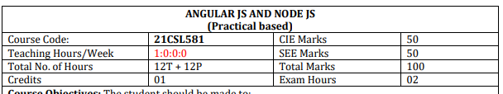
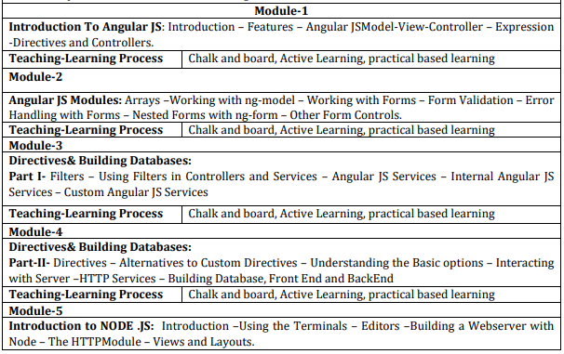

Slide 14
Pre-requisites
Html
Css
Javascript

Slide 15
DOWNLOADING INSTALLING ANGULAR JS

Slide 16
DIRECTIVES & EXPRESSIONS IN ANGULAR JS

Slide 17
DIRECTIVES IN ANGULAR JS
AngularJS lets you extend HTML with new attributes called Directives.
AngularJS has a set of built-in directives which offers functionality to your applications.
AngularJS also lets you define your own directives.
AngularJS directives are extended HTML attributes with the prefix ng-.
The ng-app directive initializes or starts an AngularJS application.

Slide 18
EXPRESSIONS IN ANGULAR JS
AngularJS expression is similar to JavaScript code snippets.
It works with numbers and strings.
{{5+6}}
{{“Hello Student!”}}
It can also work with JavaScript objects and arrays.
{{ user.name }}
{{ items[index] }}
You can write expressions wherever you like, AngularJS will simply resolve the expression and return the result.

Slide 19
AngularJS Expressions vs. JavaScript Expressions
Like JavaScript expressions, AngularJS expressions can contain literals, operators, and variables.
Unlike JavaScript expressions, AngularJS expressions can be written inside HTML.
AngularJS expressions do not support conditionals, loops, and exceptions, while JavaScript expressions do.
AngularJS expressions support filters, while JavaScript expressions do not.

Slide 20
NG-APP DIRECTIVE IN ANGULAR JS

Slide 21
NG-APP DIRECTIVE
Initialization Point: ng-app is an AngularJS directive that specifies the root element where AngularJS will initialize.
It tells AngularJS where your application begins.
In AngularJS, we create single-page applications (SPAs) where most of the application logic resides on a single HTML page.
The ng-app directive defines the boundary of your SPA.

Slide 22
NG-INIT DIRECTIVE IN ANGULAR JS

Slide 23
NG-INIT DIRECTIVE
The ng-init directive initializes application data like variables, arrays, objects, array of objects etc.
It defines the initial value for an AngularJS application and assigns values to the variables.

Slide 24
NG-REPEAT IN ANGULAR JS

Slide 25
NG-REPEAT IN ANGULAR JS
The ng-repeat directive repeats a set of HTML, a given number of times.
The set of HTML will be repeated once per item in a collection.
The collection must be an array or an object.

Slide 26
NG-MODEL & NG-BIND DIRECTIVE IN ANGULAR JS

Slide 27
NG-MODEL DIRECTIVE
With the ng-model directive you can bind the value of an input field to a variable created in AngularJS.
The ng-model directive binds the value of HTML controls (input, select, textarea) to application data.
The ng-bind directive tells AngularJS to replace the content of an HTML element with the value of a given variable, or expression.

Slide 28
mvc IN ANGULAR JS

Slide 29
MVC IN ANGULAR JS
MVC stands for
M – Model – Contains Application Data
V – View – Contains Presentation Logic
C – Controller – Creates communication path between Model and View

Slide 30

REAL LIFE EXAMPLE OF MVC

Slide 31
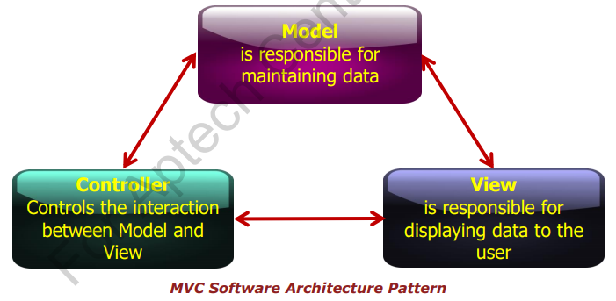
MVC Concepts

Slide 32
<html ng-app="myApp">
<script src="angularjs.js"></script>
<script>
var app = angular.module("myApp", []);
app.controller("myController", function($scope) {
$scope.message = "Welcome to RNSIT";
});
</script>
<body ng-controller="myController">
<div >
<h2>{{message}}</h2>
<h2 ng-bind="message"></h2>
</div >
</body>
</html>

Slide 33
AngularJS Module:
angular.module("myApp", [])
This line defines an AngularJS module named "myApp" using the angular.module function.
The first parameter is the name of the module, and the second parameter is an array of dependencies (currently empty in this case).
Modules in AngularJS are used to encapsulate different parts of an application, such as controllers, services, and directives.

Slide 34
Controller Definition:
.controller("myController", function($scope) { ... })
This part defines an AngularJS controller named "myController" within the "myApp" module.
Controllers are responsible for handling the logic and data of a specific view.
The controller function takes the $scope parameter, which is an object that serves as the model for the view.

Slide 35
Controller Function:
function($scope) { ... }
This is the controller function that gets executed when the "myController" controller is instantiated.
It takes the $scope object as a parameter, allowing you to interact with the view.

Slide 36
SCOPE IN ANGULAR JS

Slide 37
SCOPE IN ANGULAR JS
The scope of AngularJS is the model.
It is a JavaScript object with properties and methods available for both the view and the controller.
It gives the execution context for expressions used in the application.

Slide 38
SCOPE IN ANGULAR JS
The scope is the binding part between the HTML (view) and the JavaScript (controller).
The scope is an object with the available properties and methods.
The scope is available for both the view and the controller.

Slide 39
Understanding the Scope
The $scope is glue between a controller and view (HTML). It transfers data from the controller to view and vice-versa.
VIEW
MODEL

Slide 40
Understanding the Scope
As we have seen in the controller section, we can attach properties and methods to the $scope object inside controller function.
The view can display $scope data using an expression, ng-model, or ng-bind directive

Slide 41
key uses of $scope
Data Binding:
$scope facilitates two-way data binding between the controller and the view.
Any changes made to the properties of $scope in the controller are automatically reflected in the view, and vice versa.

Slide 42
key uses of $scope
Dependency Injection:
$scope is injected into the controller function by AngularJS's dependency injection system.
This means you don't have to explicitly create the $scope object;
AngularJS provides it .

Slide 43
key uses of $scope
Sharing Data Between Components:
$scope allows you to share data between different parts of your application.
If you have nested controllers or components, they can access and modify shared data through their respective $scope objects.

Slide 44
key uses of $scope
Event Handling:
$scope allows you to handle events in the controller and trigger actions in the view.
For example, you can use $scope to define functions in the controller that respond to user interactions, such as button clicks.

Slide 45
Understanding the Scope
The three types of scopes are:
Isolated scope
Shared scope
Inherited scope

Slide 46
Root Scope
All applications have a $rootScope which is the scope created on the HTML element that contains the ng-app directive.
The rootScope is available in the entire application.
If a variable has the same name in both the current scope and in the rootScope, the application uses the one in the current scope.

Slide 47
Scope Inheritance
PARENT
CHILD

Slide 48
DATA BINDING IN ANGULAR JS

Slide 49
What is data binding?
Data binding is a process of combining data between the model and the view.

Slide 50
TYPES OF DATA BINDING
1. ONE WAY DATA-BINDING
2. TWO WAY DATA-BINDING

Slide 51
1. ONE WAY DATA-BINDING
MODEL
DATA FLOWS FROM
MODEL TO VIEW ONLY
VIEW

Slide 52
ONE WAY DATA-BINDING
One-way data binding in AngularJS means binding data from Model to View.
In one way data- binding data flows from the scope/controller to the view
'ng-bind' is an angular directive used for achieving one-way data binding

Slide 53
TWO WAY DATA-BINDING
MODEL
DATA FLOWS FROM
VIEW TO MODEL
DATA FLOWS FROM
MODEL TO VIEW
VIEW

Slide 54
TWO WAY DATA-BINDING
Two Way Data binding is the synchronization between the model and the view.
When data in the model changes, the view reflects the change, and when data in the view changes, the model is updated as well.
'ng-model' is an angular directive used for achieving two-way data binding

Slide 55
FILTERS IN ANGULAR JS

Slide 56
Filters
Filters can be added in AngularJS to format data.
They format the value of an expression for displaying to the end user.
They are added to expressions by using the pipe character |, followed by a filter.
Filters can be used in view templates as well as in controllers.

Slide 57
AngularJS Filters
AngularJS provides filters to transform data:
Lowercase - Format a string to lower case.
Uppercase - Format a string to upper case
Number - Format a number to a string.
Currency - Format a number to a currency format.
Date - Format a date to a specified format.

Slide 58
FORMATS FOR DATE FILTER
The date filter formats a date to a specified format.
"yyyy" year (2023)
"yy" year (23)
"y" year (2023)
"MMMM" month (January)
"MMM" month (Jan)
"MM" month (01)
"M" month (1)

Slide 59
FORMATS FOR DATE FILTER
"dd" day (06)
"d" day (6)
"EEEE" day (Tuesday)
"EEE" day (Tue)

Slide 60
FORMATS FOR TIME IN DATE FILTER
"HH" hour, 00-23 (09)
"H" hour 0-23 (9)
"hh" hour, 00-12 (09)
"h" hour, 0-12 (9)
"mm" minute (05)
"m" minute (5)

Slide 61
FORMATS FOR TIME IN DATE FILTER
"ss" second (05)
"s" second (5)
"sss" millisecond (035)
"a" (AM/PM)

Slide 62
FORMATS FOR DATE FILTER
The format value can also be one of the following predefined formats:
"short" same as "M/d/yy h:mm a" (1/5/23 9:05 AM)
"medium" same as "MMM d, y h:mm:ss a" (Jan 5, 2023 9:05:05 AM)
"shortDate" same as "M/d/yy" (1/5/23)
"mediumDate" same as "MMM d, y" (Jan 5, 2023)
"longDate" same as "MMMM d, y" (January 5, 2023)
"fullDate" same as "EEEE, MMMM d, y" (Tuesday, January 5, 2023)
"shortTime" same as "h:mm a" (9:05 AM)
"mediumTime" same as "h:mm:ss a" (9:05:05 AM)

Slide 63
Order-by filter IN ANGULAR JS

Slide 64
orderBy Filter
It will provide sorting of arrays in ascending or descending order.
<ul>
<li ng-repeat="n in names | orderBy">{{n}}</li>
<br>
<li ng-repeat="n in names | orderBy:'reverse'">
{{n}}</li>
</ul>

Slide 65
search Filter
<ul>
<li ng-repeat="item in items | filter: searchText">
{{item }}</li>
</ul>

Slide 66
Limit-to filter IN ANGULAR JS
PRESENTER: MOHAMMAD ADIL

Slide 67
limitTo
limitTo
Limits an array, into a specified number of elements/characters.
When the limitTo filter is used for arrays, it returns an array containing only the specified number of items.
<ul>
<li ng-repeat="item in items | limitTo: 3">{{ item }}</li>
</ul>

Slide 68
<ul>
<li ng-repeat="item in items | orderBy: '-name' | limitTo: 3">
{{ item }}</li>
</ul>

Slide 69
EVENTS and event HANDLING IN ANGULAR JS

Slide 70
What are Events?
Events are "things" that happen to HTML elements.
AngularJs can "react" on these events.
Here are some examples of events:
An HTML web page has finished loading
An HTML input field was changed
An HTML button was clicked

Slide 71
Mouse Events
On Mouse click
ng-click
ng-mousedown
ng-mouseup
ng-dblclick

Slide 72
Mouse Events
Mouse events occur when the cursor moves over an element, in this order:
ng-mouseover
ng-mouseenter
ng-mousemove
ng-mouseleave

Slide 73
ng-change directive
The ng-change directive tells AngularJS what to do when the value of an HTML element changes like textbox, select, textarea.
The ng-change directive requires a ng-model directive to be present.
The ng-change event is triggered at every change in the value. It will not wait until all changes are made, or when the input field loses focus.
The ng-change event is only triggered if there is a actual change in the input value, and not if the change was made from a JavaScript.

Slide 74
KeyBoard Events
Executes when we enter a keyboard button.
ng-keydown
ng-keypress
ng-keyup

Slide 75
Copy Paste Events
Executes when do some cut copy paste operation on input fields.
ng-copy
ng-cut
ng-paste

Slide 76
NG-SHOW AND NG-HIDE DIRECTIVES IN ANGULAR JS

Slide 77
NG-SHOW DIRECTIVE
The ng-show directive shows the specified HTML element if the expression evaluates to true, otherwise the HTML element is hidden.

Slide 78
NG-HIDE DIRECTIVE
The ng-hide directive hides the HTML element if the expression evaluates to true.
ng-hide is also a predefined CSS class in AngularJS, and sets the element's display to none.

Slide 79
FORM VALIDATION IN ANGULAR-JS

Slide 80
Introduction to Forms Validation
Forms are the major way users communicate with the apps we develop and are an important mechanism of modern Websites and applications.
They are used to collect data form the users.
The data collected by the form is validated before sending it to the server.
AngularJS continuously oversees the status of the form and their input fields such as input, textarea, select and help us advise the user about the current state.

Slide 81
Form states
Form is a collection of related individual controls grouped together. For example, Login form -> allows users to input their credential to enter the application.
Angular Form has some additional capabilities than plain HTML forms.
It gives developers more control on how to communicate with the form.
While creating Angular form, AngularJS creates an instance of FormController.

Slide 82
Properties
$untouched: The field has not been touched yet
$touched: The field has been touched
$pristine: The field has not been modified yet
$dirty: The field has been modified
$invalid: The field content is not valid
$valid: The field content is valid

